Slide 1

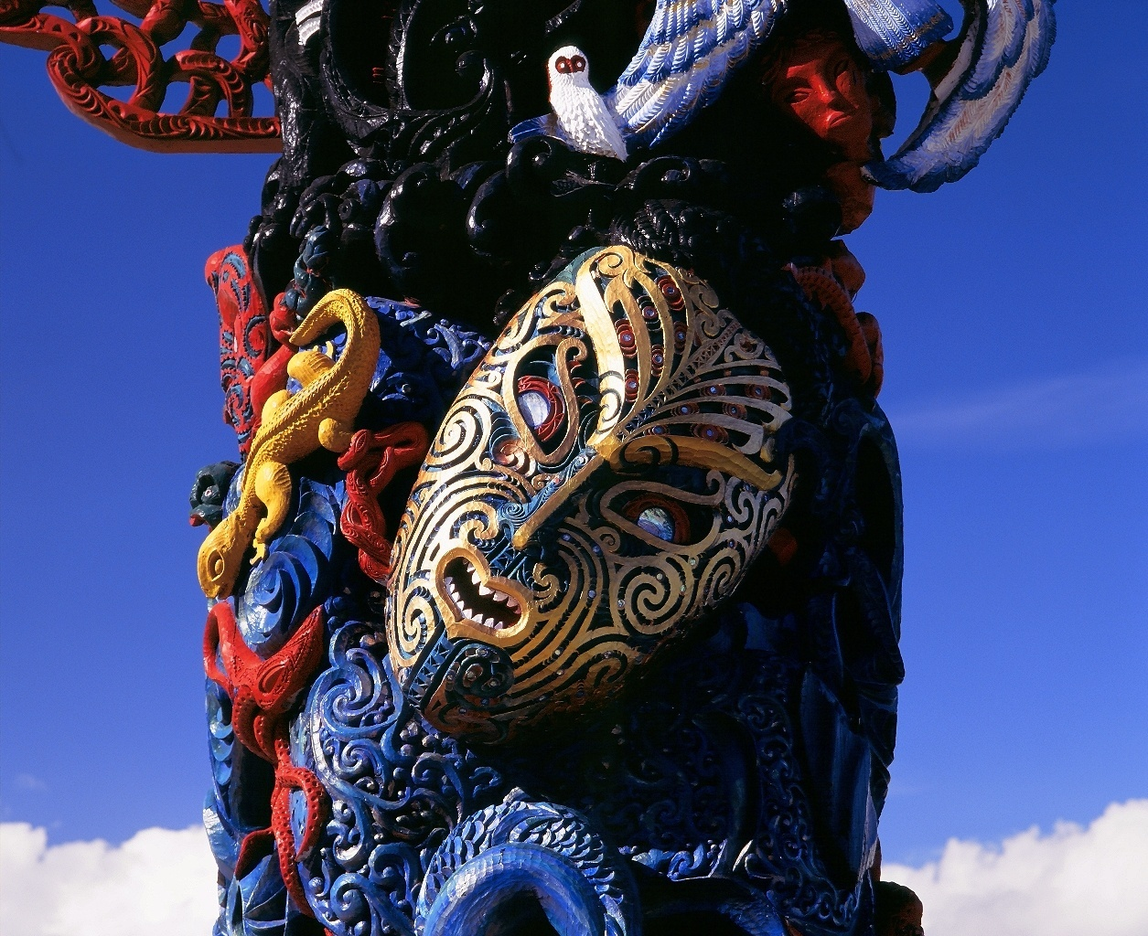
HAKAMANA

Slide 2

HAKAMANA
Integrated System of Transformative
Design, Development & Evaluation
The HAKAMANA Integrated System of Transformative Design, Development & Evaluation
is Copyright © Tania Wolfgramm-Kingi / Pou Kapua – Creatrix 2010.

Slide 3

HAKAMANA is informed by the sounds and words of the ancient Oceanic / Polynesian / Maori language
I – O – E – A – U
simultaneously ‘verbs’ and ‘nouns’, processes and outcomes.
  These sounds communicate states:
  of relationship, creativity and potentiality,
  of constancy on the one hand
  of dynamic change on the other
  that embody transformative processes

Slide 4


HAKAMANA
I
O
E
U
A
UI
IO
AU
OE
EA

Slide 5
HAKAMANA
I
TIKI
O
HONO
E
RERE
U
TUPU
A
HAKA
hui nui
tui
pio tio
UI
IO
hau kau rau
koe hoe
moe
AU
OE
EA
hea mea pea

Slide 6
HAKAMANA
Values & Principles of engagement
Aroha / Care & Compassion
Values; Wairua; Ethics; Concepts Share Vision; Co-create ethical space
Titiro
I
Vision
Kotahi
O
Relate
Rewa
E
Activate
Tupu
U
Sustain
Rawa
A
Achieve
UI
IO
Rangatiratanga
Leadership
Puawaitanga; Share;
Open Opportunities
Sustain Benefits;
Enable Leadership
Tikanga / Ethical Integrity
Whanaungatanga
Connect; Collaborate
Whakapono; Respect; Genuine Partnerships Co-create / co-design / plan / strategise
OE
AU
MAURI / Mana & Life force
Reflect; Reorient; Mediate Fail in Safety; Evaluate; Learn; Whole of Systems Solutions Achieve Intentional Excellence
Manaakitanga / Generosity Guardianship; Activate; Support; Implement; Real Engagement; Meaningful participation Provide / Operationalise / Deliver
EA

Slide 7
HAKAMANA contains many important elements, including
HA – the breathe of life - connects all living things
KA – the fire that burns within us – energy to transform
MA – the presence of all of one’s ‘light’, knowledge of self
NA – our relationships - respectful kinship
HAKA – the ‘dance of life and energy’ – animation / activation
MANA – the power, strength and authority, leadership
HAKAMANA – the creative process of realising one’s power

Slide 8
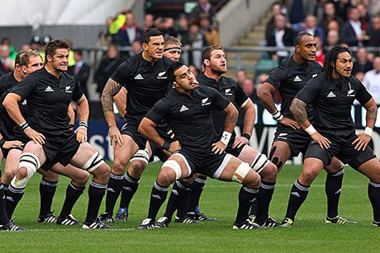

All Blacks
… gearing up for the final game …
All Blacks
… winning the World Cup!!!

Slide 9
HAKAMANA – A co-creative process
The HAKAMANA System of Transformative Design,
Development, Implementation & Evaluation
    opens your creativity and allows you to move through complex systems with ease. It engages a system wide approach to thinking that shifts the focus from individual parts to their interactions. It allows you to move through complex and dynamic relationships, creating robust solutions with tangible outcomes.

Slide 10
HAKAMANA – Co-design, Activate, Transform
Journey
Vision / Values / Ethics
Conceptualise / Engage
Titiro
I
Vision
Kotahi
O
Relate
Rewa
E
Activate
Tupu
U
Sustain
Rawa
A
Achieve
Lead / Share
UI
IO
Design Concepts
Achieve Outcomes
Sustain Benefits
Share success
Co-Design / Define
Strategise / Plan
Strengthen teams
Realise Outcomes
Connect
Collaborate
AU
OE
Reflect / Learn
Measure / Analyse
Quality Improvement
Activate / Implement
Integrate Operations
Roles / Responsibilities
EA
Evaluate / Learn

Slide 11
Critical theory allowed us to name and frame our situation
… it has given us a sense of present realities.
Now the onus is on our shoulders to create
… to essentially imagine a possible future for us.
This requires our creative processes to kick in
… as they do when we create an art piece.”
(Professor Gregory Cajete, Aotearoa New Zealand 2009)
HAKAMANA
your vision … your kaupapa
be creative … be co-creative
dream – be – do – live - thrive

Slide 12

Case Studies
The application of
HAKAMANA
Past / Present / Future

Slide 13
Case Studies
Beyond Sectors … | KO WAI - Who HE AHA - What | HAKAMANA
Creative | Pou Kapua | Creating the largest Maori / Pacific Pou carving in the world
NZ Health | Fanau Ola | Supporting Pacific patients and fanau as they move from hospital to home
International Health | Samoa NHS | Co-creating an evaluation framework for Samoa National Health Services
Tribal Universe | Technological Sovereignty | Supporting technological growth to increase Indigenous wealth and wellbeing
Technology | SmartPath | Developing a cloud-based patient portal that opens the doorways to better health

Slide 14
Case Study 1
HAKAMANA
Pou Kapua
The largest Māori / Pacific
Pou carving in the World

Slide 15
THE INTENTION
To create a cultural legacy, the largest Māori / Pacific Pou carving in the world, a symbol and icon of culture and sovereignty
THE Outcome
Pou Kapua – a testimony to the world, the tallest Māori / Pacific Pou (carving) in the world (80 feet; 30 tonnes), carved in ancient kauri and totara, standing in Manukau, accessible to all (24/7)

Slide 16
HAKAMANA – Pou Kapua
Vision: Create a symbol of identity - the largest Maori / Pacific Pou in the world
Titiro
I
Vision
Kotahi
O
Relate
Rewa
E
Activate
Tupu
U
Sustain
Rawa
A
Achieve
Pou Kapua shares intrinsic knowledge with the World
UI
IO
Values, tikanga, co-design wananga; planning
Pou Kapua completed Puawaitanga at dawn; stands in Manukau; gift to the world
Gather Tohunga, Master Carvers, and Specialists, recognise talents
Pou carved, engineered as whole
Connect
Collaborate roles agreed, responsibilities
AU
OE
Create Pou, bring together all elements to create / express Pou; animate vision
Secure kauri and resources; work spaces; funding; start carving
EA
Methods, Evaluation, Ongoing Learning

Slide 17
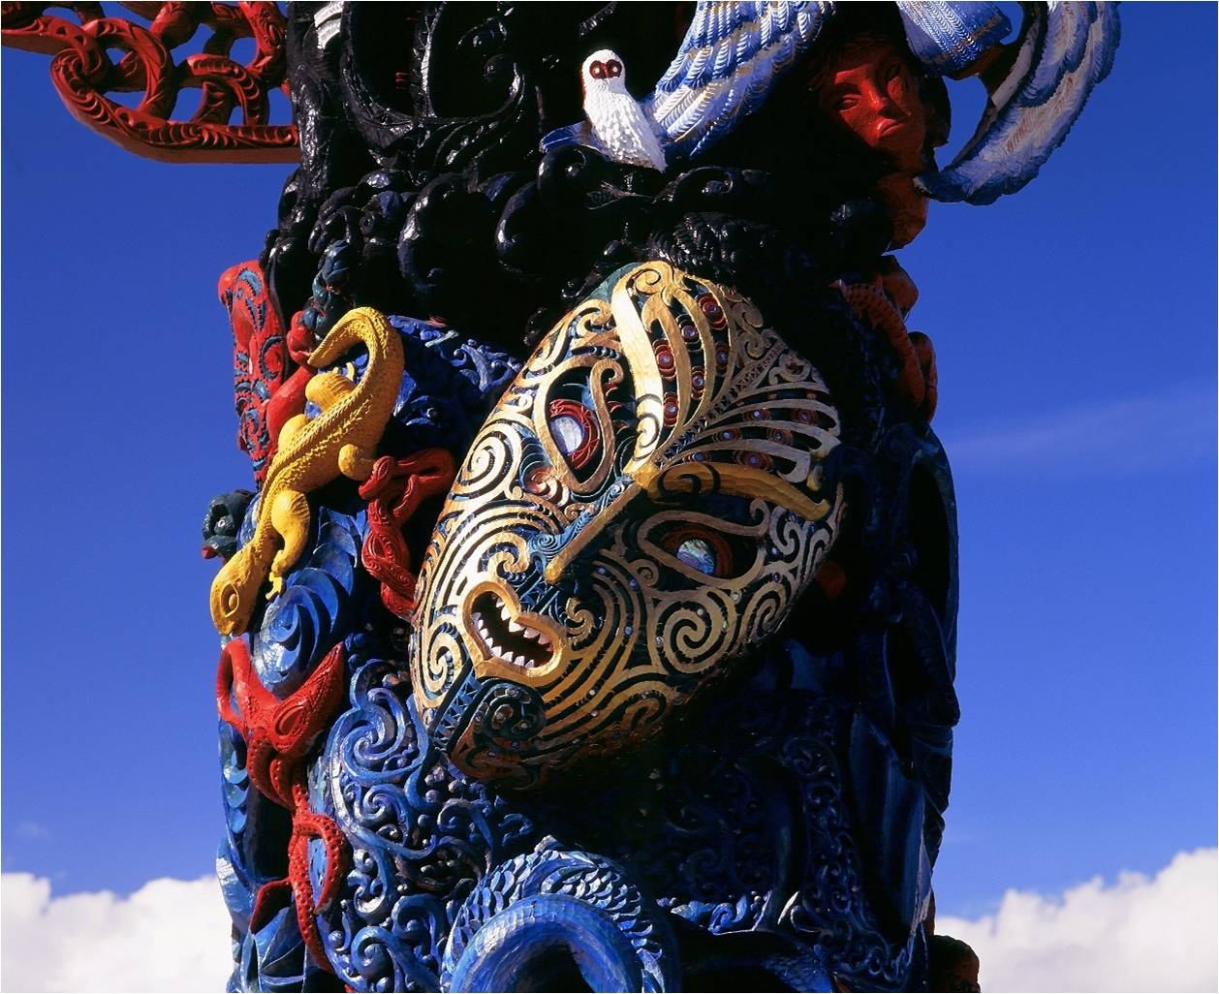

Slide 18
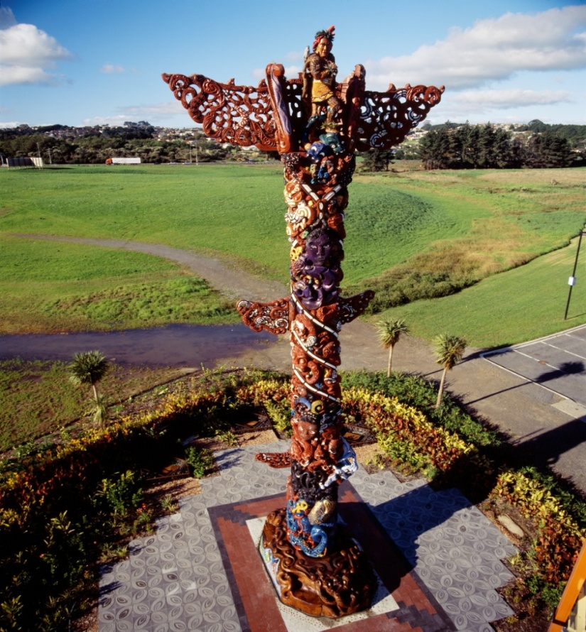
Pou Kapua
Aha koa he moemoea,
he Taonga
A legacy entrusted,
a dream fulfilled,
a treasure revealed
A gift from the tribes and people of Aotearoa/Pacific, to the World

Slide 19

Case Study 2
HAKAMANA
Pacific Fanau Ola
Fanau-Centred Patient Care

Slide 20
THE INTENTION
To design and implement a healthcare solution for Pacific patients (with complex health needs and who have multiple socio-economic challenges) that includes their fanau / family members as important members of their circle of care; and provide quality patient and fanau-centric care to achieve better health outcomes
THE Outcome
The design, development and implementation of a Fanau Ola Support Service with an evaluation that shows a decline and reduction over time in secondary service utilisations (hospital admissions, emergency care presentations), and improved quality of life for Pacific patients and fanau

Slide 21
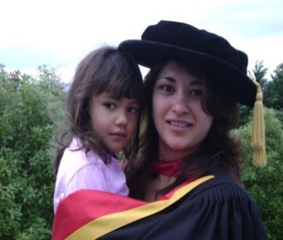
Vision: Fanau Ola for Pacific families
Fanau will be…
healthy in body, mind and spirit, educated, socially strong, and content.
Fanau will have…
the courage and will to live, the skills and abilities
to plan and pursue their own futures.

Slide 22
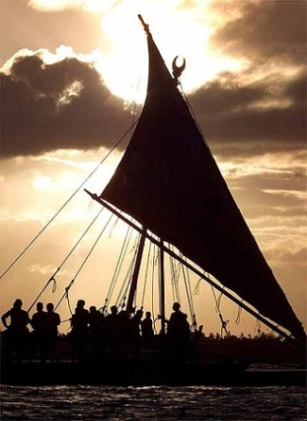
Fanau Ola
Ancient Pacific words – expressing many sounds of creation;
‘ha’ the ‘breath of life’ and
‘wa’ inferring ‘time and space’
combine to form the sound
  ‘fa’, a number - signifying foundations of family life
  ‘na’, interweaving family relationships with each other
  ‘u’, manifesting the realisation of the family’s potential
  ‘o’, animating the family space of creativity
  ‘la’, embracing the warmth of the sun as families grow

Slide 23
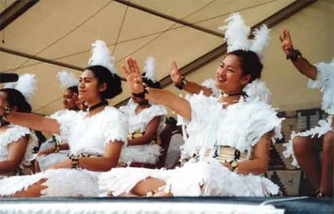
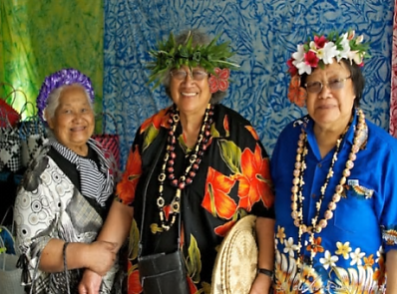
Fanau Ola encompasses…
VISION Fanau Futures / Goals / Plans
SOCIAL Relationships / Caring Connections
CULTURE Worldview / Tradition / Language
BODY Physical Health / Conditions / Risks
SPIRIT Spirituality / Beliefs / Religion
HEART Emotional Wellbeing / Love / Support
MIND Learning / Intellect / Education / Skills
RESOURCES Resources / Housing / Income / Technology
CONTEXT Environment / Community / Systems
LEADERSHIP Leadership & Guidance Skills / Fanau Champions

Slide 24
Fanau Ola Support Service – helping our most unwell Pacific patients and fanau achieve better health outcomes
Vulnerable & Complex
Highest Risk
High Risk
Moderate Risk
Pasifika Fanau in Communities
In-Patient / Fanau Ola Journey
Pacific focused services
Primary Care PHO Practices Localities
Whanau Ora Commissioning
Community Providers Churches
DHB / Hospital Secondary Care
Primary Providers

Slide 25
Fanau Ola Support Service in Hospital
Fanau Ola
1. Patient / Fanau Engagement Consent Enrolment
2.Patient / Fanau Assessment Analysis Planning
3. Patient / Fanau Support Services & Care
4. Patient / Fanau Evaluation Learning Success
5. Patient / Fanau Sustainability Strategy

Slide 26
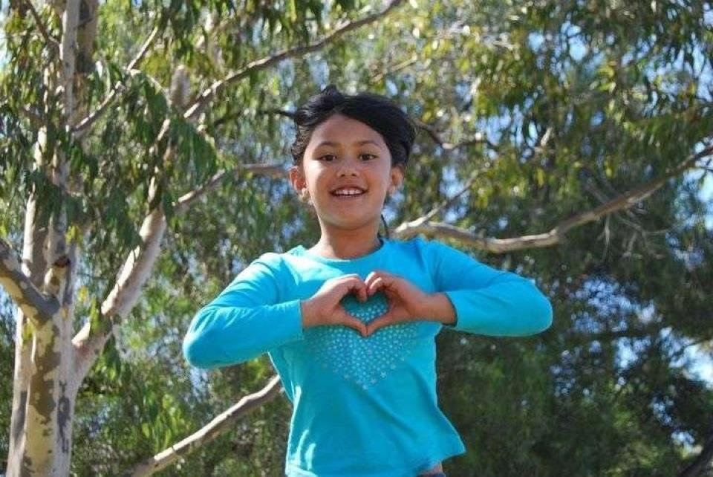
The story so far …
Period: 1 July 2013 – 31 Mar 2015
2725 Pacific Patients
11256 Fanau Members

Slide 27
Public Health Evaluation - Findings
Reductions in secondary service utilisation following intervention by both Pacific Cultural Support Team and Fanau Ola Support Service
Reductions over time in secondary service utilisation prior to enrolment in Fanau Ola Support Service

Slide 28
Case Study Research - Findings
The important role of family as main carers and supporters
Fanau need support to understanding and navigate complex health and social systems (which also need to be more patient & fanau-centric)
The impact of health beliefs and attitudes and previous experiences of health services

Slide 29
Number of hospitalisations, bed days and average length of stay to CM Health facilities for the PCST ≥5 cohort and the Fanau Ola Support Service Jul-Dec13 cohort six months before and six months after the intervention, all admission types

Slide 30
Number of emergency care attendances, hospitalisations and bed days at CM Health facilities for the Jul-Dec 13 and Mar-Aug 14 Fanau Ola Support Service cohorts six months before the intervention
Utilisation | Fanau Ola Support Service Jul-Dec 2013 Total | Fanau Ola Support Service Jul-Dec 2013 per patient | Fanau Ola Support Service Mar-Aug 2014 Total | Fanau Ola Support Service Mar-Aug 2014 per patient | Percentage difference between cohorts
ED attendances | 723 | 2.25 | 1205 | 1.66 | -36%
Hospitalisations | 582 | 1.81 | 834 | 1.15 | -58%
Bed days | 2,017 | 6.28 | 2,339 | 3.22 | -95%

Slide 31
Case Study 3
HAKAMANA
Samoa National Health Services
E Fa’atauaina Lou Soifua
Your Health is Our Priority

Slide 32
THE INTENTION
To develop a monitoring and evaluation framework for Samoa National Health Services that is centred on the vision and values of the people of Samoa – to achieve better health for all
THE Outcome
The design, development, and implementation of a Samoa NHS Monitoring & Evaluation Framework that has buy-in from all levels of the organisation, takes a whole-of-system approach, is aligned with their corporate plan, and includes key elements of strategic development and sustainability of better health outcomes for Samoa

Slide 33

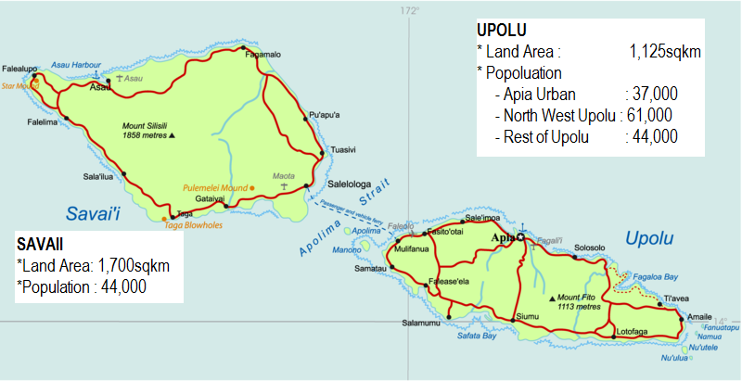
Samoa National Health Services Today
Challenge: Providing Quality Services to the people of Samoa with few resources
Health Service Provider for
190,000 people in:
Upolu > TTM, 3 DHs, 3 MCs,
Savaii > MTII, 3 DHs, 1 MC
Personnel :
57 Doctors, 432 Nurses,
200 Allied, 201 Other
Budget ( 15/16 ) 67 Million (8%)
Total Assets : $157 Million
Population Growth Rate: 0.59%
Population Density: 64 /Sq km
Life expectancy at birth: 73 years - (Males: 70 yrs, Females: 76 yrs)
Child mortality; High and multiple morbidities; Rising rates of NCDs
GDP: 1 BILLION TALA
GDP per capita: $ 5,300

Slide 34
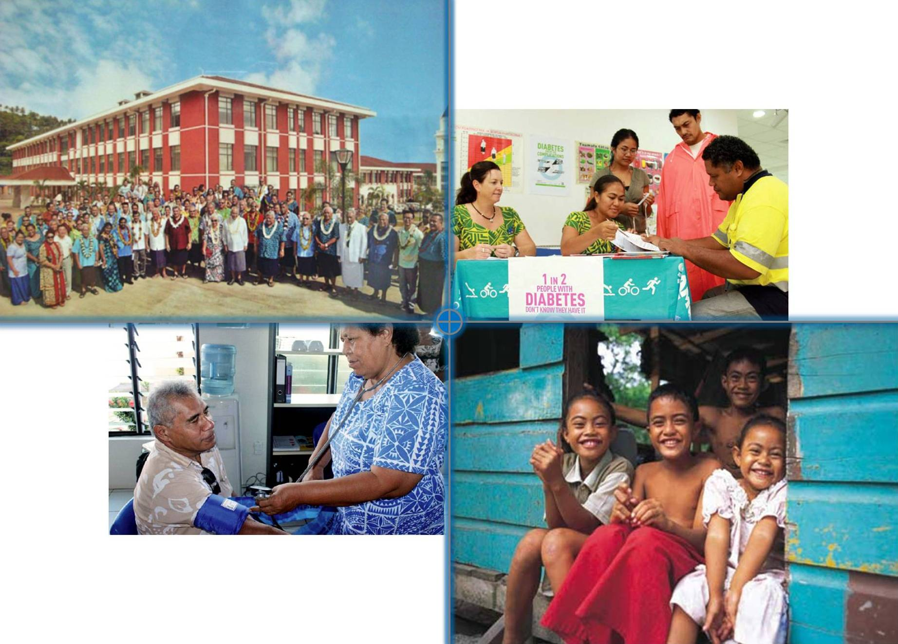
Anavatau
Vatapuia
E Fa’atauaina Lou Soifua
Fa’aauau
Ausia
Fa’asino

Slide 35
Better Health & Wellbeing
Vision; Values; Ethics
Culture of Care & Compassion
Equality; Fairness; Human Rights
Accessible / Affordable / Equitable
Anavatau
Vision
Vatapuia
Relate
Fa’asino
Activate
Fa’aauau
Sustain
Ausia
Achieve
Sustainable Outcomes
Quality Health System Management Policy / Strategic Development Planning / Legal / Audit
Monitoring / Evaluation
Reporting / Dissemination
Integrity & Commitment
Governance / Leadership
Strong Organisation
Human Resources
Teamwork; Partnerships
Accountability; Transparency
Where do we want to be?
E Fa’atauaina Lou Soifua
Where are we now?
Where have we come from?
Excellent Service Delivery Hospital/Primary/Community/ Outreach Disaster & Emergency
Patient Related Medical Services
Quality Patient Care for
Everyone … Everywhere … All the Time
Whole of Systems Solutions Infrastructure – Integration
Finance / Allied / Supplies
Building / Plant / Equip / Transport
Information, Communication, Technology

Slide 36
Case Study 4
HAKAMANA
Co-Design Lab
Novel solutions for complex challenges

Slide 37
THE INTENTION
To develop an evaluation plan and method for exploring the effectiveness of the approach of the Co-Design Lab to achieve their vision of “working together to solve tough problems”
THE Outcome
A robust and dynamic HAKAMANA framework, including evaluation mechanisms that support the Co-Design Lab and that can be applied across and within multiple levels of the Co-Design approach and environment

Slide 38

Working Together to Solve Some of Our Toughest Problems
The Auckland Co-design Lab (Co-Lab) was established to explore the case for change for using a co-design and innovative approach to solving complex social issues, with a focus on South Auckland.
The Co-Lab has the following key objectives:
Develop radical and novel solutions for challenges that are complex, multi-agency, social issues;
Accelerate the delivery of solutions that can help meet desired public sector outcomes;
Provide approaches that can support development of customer-centred solutions in association with private businesses, local government, non-governmental agencies, communities and citizens and achieve collective impact; and
Explore the use of innovation tools for improving public services at a system level, ensuring the approach includes the requirement to scale and implement solutions from the start.

Slide 39
HAKAMANA Co-Design Lab
HYPOTHESIS Stage
Titiro
I
Vision
Kotahi
O
Relate
Rewa
E
Activate
Tupu
U
Sustain
Rawa
A
Achieve
Lead / Share
Design Concepts
UI
IO
REVIEW Stage
EXPLORE Stage
Realise Outcomes
Connect
Collaborate
AU
OE
TEST
Stage
IMAGINE
Stage
EA
Evaluate / Learn

Slide 40
Case Study 5
HAKAMANA
Tribal Universe
To support technological growth
to increase Indigenous
wealth and wellbeing

Slide 41
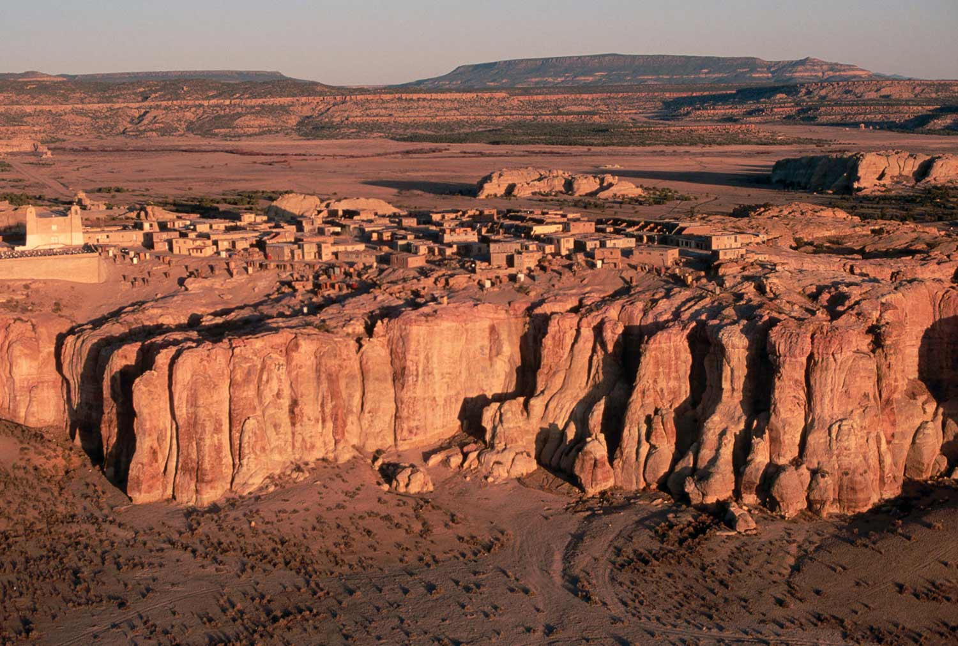
Notes:
Acoma Pueblo – native science and technologies sustaining native communities

Slide 42

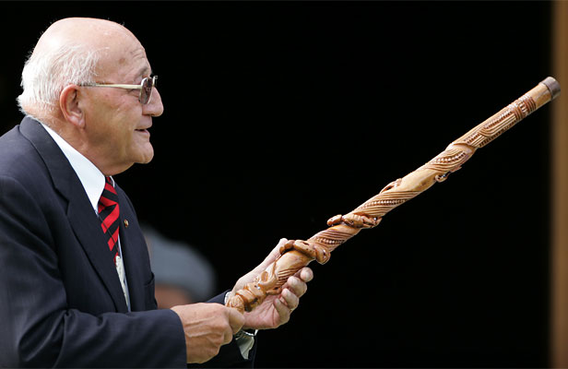
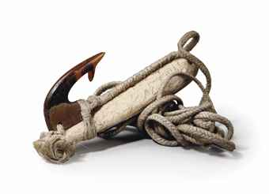
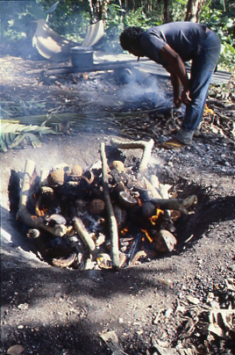
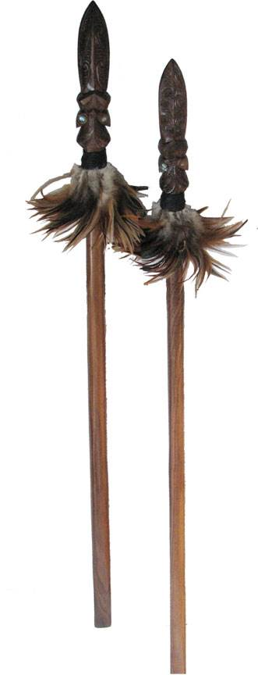
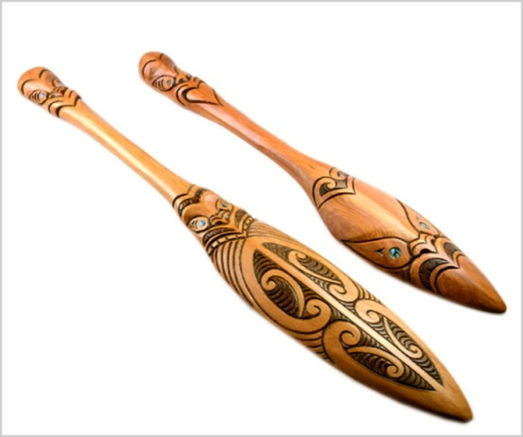
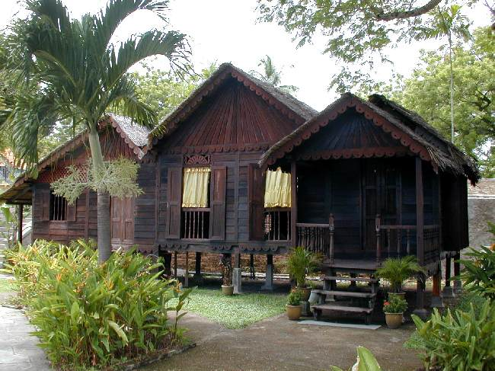
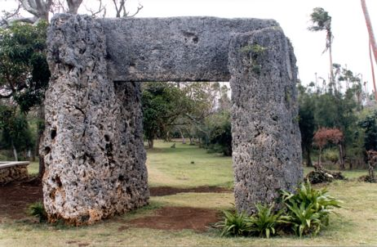
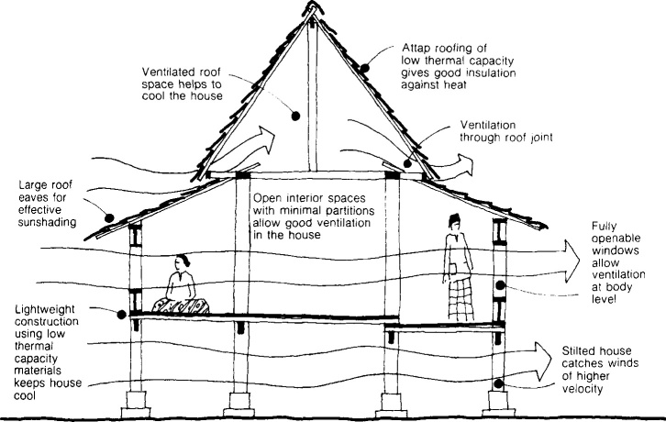
Traditional Technologies

Slide 43
Characteristics of Technology…
Express Values – Vision
Art of skillful living
Food, clothing, shelter, communication, travel
Culture, identity, language, custom - authenticity
Intrinsic value - ancestry
Animate - nurture spirit and life force
Education, Health, Medicine, Environment, Community
Notes:
Characteristics of Indigenous Technology
Māori, Pacific, and Indigenous technologies are recognised as animate; imbued with the breath of life, they exist in form and function having emerged from the implicate order. They symbolise the collective nature of our cultures while acknowledging our diverse and unique identities as individual Indigenous people in relationship with the whole. Indigenous technologies express our dreams, visions and imaginings and they come into being to nurture our spirit and life force in its expression.
Māori, Pacific, and Indigenous technologies are created within complex sensory environments that build on our sense of relationship, meaning, balance, feeling, memory and place as well as sight, sound, smell, taste and touch. In meaningful interactions they engage and evoke significant knowledge and experiences unique to the Indigenous world. They bring to mind [and heart] oceans, seas, rivers, lakes, lagoons; mountainous lands and rich forests; low-lying islands and tropical fruits; nature in times of abundance, and nature in times of scarcity. Indigenous technologies are pragmatic and reflect the art of skillful living. Developing Indigenous technology is part of the human life pattern; part of the human journey. Indigenous technologies move through the river of life, over the currents of time gathering from the cultures and environments through which they pass, being refined and adapted, growing, innovating, and dissolving into the cycle of knowledge. They are intended to enhance the ability to maintain and renew balance and harmony within a multi-dimensional, complex and interconnected environment.
Experimentation, Adaptability, Innovation
Māori, Pacific and Indigenous peoples across the globe have developed technologies since they came into being, including tools for building, measuring, carving, hunting, holding, preserving food, and making clothing; technologies for communicating across distances; ceremonial objects and regalia for communicating with the spiritual realm through song, dance and ritual; objects to entertain and stimulate; implements that employ sound and wind; gauges for travel and navigation; methods for the transport of goods and materials; instruments for making art and music, for compounding medicines, for cultivation and gathering, for the holding and passing of information and on and on, all emerging in response to the myriad needs of a dynamic community.
Malay and Pacific peoples across centuries designed, built, navigated, and sailed canoes across thousands of miles of ocean, settling new islands and seeding culture, language, and technologies across new and diverse environments. These were applied in all facets of their lives, providing shelter, food, and clothing as they learned to live in new lands. Leaders and communities needed to provide safe places that allowed for experimentation and failure. These were places for resilience and reflection, where the learning spirit(s) were nourished and the learning processes inextricably linked within conscious relationship to the whole. In this relationship we continue to check that what is being created is in alignment with the unfolding of the natural order. And that these creators, technologies, and tools, are responsible to the ecologies that birthed them, and that their impact on the future generations is being fully considered.
Knowledge Stewardship and Information Technology
We do not own knowledge; we are knowledge holders. Knowledge transfer in Indigenous culture reflects ecologies of relationships, appropriate to the space and place. Indigenous technologies attract the learning spirit(s) and provide learning environments that support the transformation and revitalization of awareness and knowledge of humanity, the social and natural world. As we endeavour to meet our obligation to transfer knowledge as part of the human journey, we ask ourselves, how well have we learned; how we have held knowledge; and how our knowledge been used and experienced.
In Indigenous worldviews all technology is information technology. Any technology or tool is informed by or contains the information embodied in the materials; the knowledge, skill, and intention of the maker; and the collection of knowledge accumulated by its users. An Indigenous Information Technology is one in which the tools are in proper relationship with the community, the tools function correctly in the community ecology, and support the community’s future. Design, management and use of technology are a conscious relationship. All parties are in relationship and the intention is to ensure that the tools are used properly to support the community. These are functions we recognise must be implemented in an information technology that reflects Indigenous consciousness.
In the Indigenous worldview of time we are simultaneously connected to that which came before and that which will follow. Indigenous technologies have intrinsic value because we know their ancestry, where they came from, and what their place is in our world. We know they will transform and pass from this place to return to the realms of energies. Indigenous technologies have an obligation to be used within an ethical space that is responsible to life and is coherent with the natural order.
The Pukaea (traditional Polynesian trumpet) gathers and forms many sounds. “Pu” denotes our voice, our essential true being deep within us. “Kaea” is the messenger. Pukaea therefore intimates the messenger from deep within us. Our [normal] voices are used to speak to humankind. The Pukea allows a human to communicate with the energies of the implicate order using breath and sound.
While it lives in the same material world with a laptop, a cell phone, a GPS system, or a dark field microscope, we immediately recognise the Pukea as animate, a taonga, a treasure. The Pukea will not find itself in a landfill replaced with something sleeker and faster. Its efficacy has not diminished over thousands of years of use. The Pukea is an authentic example of technological design coherent with the natural order.
The ability or capacity to make something does not constitute a valid reason for its existence. Indigenous technologies have a different life trajectory than a fax machine or a mobile phone. It is clear that the western, educational processes by which modern, digital technologies attempt to enter Indigenous communities are incomplete and exacerbate the cultural disconnect for Indigenous learners of all ages. If it is to be sustainable, the way in which a technology enters an Indigenous community must reflect and animate the principles, values, and philosophies of Indigenous learning processes and world view.
Language and Technology
Language is an important vehicle by which culture, thoughts, customs, histories, and knowledge are communicated both verbally and in written form from one person to another, from one generation to the next. There are over 380 million people living in and across Malay-Polynesia who share a rich and diverse cultural and linguistic heritage. Thousands of related yet unique languages and dialects are spoken daily. These languages, developed over millennia are sacred ‘taonga’, treasures with a life-source and power that express their lives, their spaces, places, people and lived experiences.
Over time, hundreds of these languages have become extinct and we continue to lose dozens of languages every year – sadly, one language dies every day! For millions of Indigenous people, loss of their languages has meant a continuing struggle to keep their sense, understanding and knowing of themselves as individuals, families, communities and cultures, alive. Many of these are the languages of Indigenous peoples, including Māori, who struggle to keep their culture alive. Even as the world has become increasingly ‘globalised’ and ‘connected’, a significant number of people have become more isolated and disconnected from their cultural and linguistic roots.
Technology expresses, informs and transforms culture, and whilst technology can bring many benefits to our way of life and language, it can also negatively impact on linguistic and cultural expression and identity. The usual framework for the design of new technologies, including information systems, computer hardware and software, has resulted in mainly generic systems of communication being developed, which cater to linguistic majorities and ‘large markets’, and often ignore the cultural and language needs of Indigenous peoples or ‘small markets’.
The socio-cultural impact this has on societies and communities that rely on communication systems to ensure future generations of their peoples do not lose intrinsic aspects of their unique languages and worldviews is becoming more critical in our increasingly global world.

Slide 44

Technological Expansionism vs.
Technological Sovereignty
Notes:
Technological Expansionism
Technologies – the rationale for their design, development, distribution, and usage are produced within specific cultures, worldviews and value-systems. Technologies are not value-free. The values of the designers and developers of technologies and tools are indelibly stamped into them, making technologies inextricably linked with power and control. Hence technologies have widely been used as tools of oppression and supremacy, with military forces often spearheading innovative approaches. And the deliberate replacement of local technologies with Eurocentric values-laden, profit-driven technologies has been part of the colonising agenda for many centuries.
Today technological expansionism continues to thrive within an environment of globalisation, dominated by a handful of global conglomerates including several Euro/Western corporations. The information, communications, digital and computer technologies sectors and industry has generated exponential economic growth and created accelerated opportunities for high-skilled employment.
In New Zealand, the Information and Communications Technology (ICT) Sector includes 14187 firms who collectively contributed $8.4 billion to NZ GDP, and employed 73,398 people. It is a highly internationalized sector, has improved productivity, high rates of Research & Development and Innovation, and good return on investment. Notable by their absence are Māori in this sector, their participation as owners, designers, creators, producers, manufacturers and distributors. For the most part, Māori have merely become another market / consumer group for technology firms.
In order to achieve Technological Sovereignty and for Māori to benefit culturally, socially and economically, this situation must change.

Slide 45
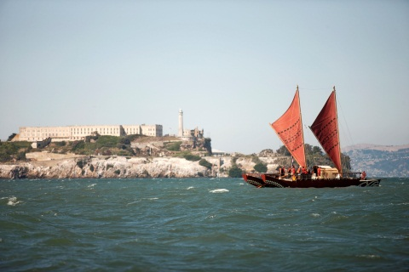
Our Challenge …

Slide 46
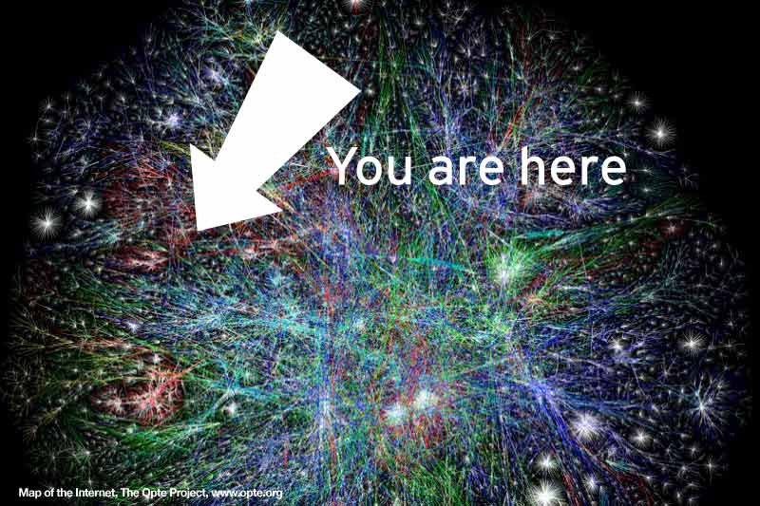

Slide 47
Space race hypertext modem mouse graphical user interface markup language personal computer the internet internet service provider hackers cyberpunk internet protocol suite desktop publishing emoticons domain name system web browser cookies jpeg porn search wifi open source content management systems web analytics online gaming webcam web standards web auction user-centred design information metadata cascading style sheets pay per click blogging scaleable vector graphics webmail viral content digital wallet ecommerce collaborative filtering web streaming independence peer to peer broadband creative commons dot-com wiki infographics augmented reality captcha photo sharing podcast long tail social networking perpetual beta online data casual gaming youtube qr code real-time reporting user generated content aggregation crowdsourcing internet elections the cloud tablets snap chat apps big data

Slide 48

Education
Health
Social
Business
Issues

Slide 49
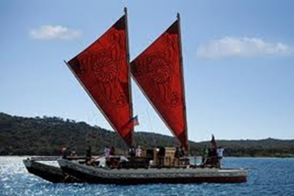
Technological Sovereignty over time
Colonisation
Industry
Corporate
Digital
Tribal Universe
Create
Engage
Thrive
INDIGENOUS TECHNOLOGICAL SOVEREIGNTY
Native
PAST
NOW
FUTURE

Slide 50
How can we remain
centred as Indigenous …in the flux…
as we co-create our
‘Tribal Universe’?

Slide 51
TRIBAL UNIVERSE
Technological Sovereignty
Wairua
Values Culture
Kotahi Participate Cooperate
Rawa Assets Resource
Rangatira Lead Flourish
Manaaki Support Innovate

Slide 52
Wairua - Spirit
Values
  Spirit of Indigenous / Pacific / Maori – Ethical Space
  Identity / Authenticity / Authority / Integrity
Cooperative Strategy / Organisation Support
  Articulate Strategic Vision
  Powerful Imagery / Tohu Aroha
  Strategic Leadership / Positioning / Marketing
Tactical Opportunities
  Essential content / key messages / whakatauki
  Communications / website / networks
Outcomes & Benefits
  Positive alignment of values [all elements]
  Greater understanding of sector / organisation
Notes:
WAIRUA

Slide 53
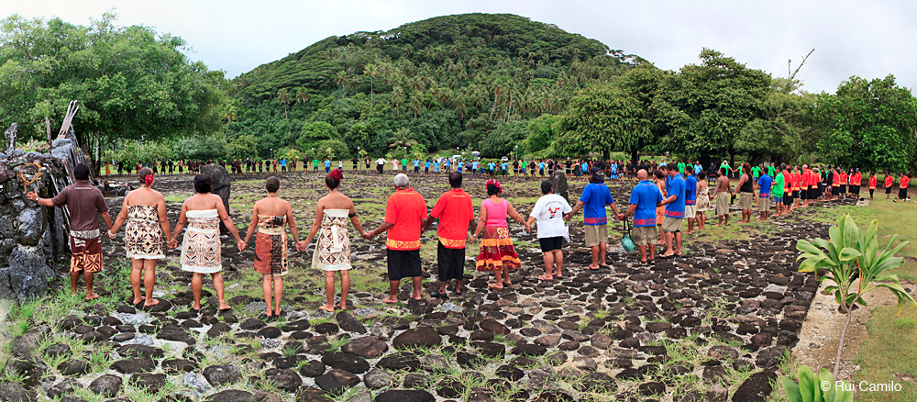
Kotahi - Together
Notes:
KOTAHI
Taputapuatea – means the courtyard of sacred potentiality
Staging point for movement

Slide 54
Kotahi - Relate
Values
  Participative / Collaborative / Cooperative
  Connected / Proactive / Strong Global Kainga
Cooperative Strategy / Organisation Support
  Invite all to engage, participate and support
  Value and enhance strengths / Create opportunities
Tactical Opportunities
  Communications infrastructure / stocktake & database development
  Co-operative projects / co-production
  Strengthen connections with global indigenous communities
Outcomes & Benefits
  Unique global network / strengthened relationships
  Increase in and improved collaborations / co-productions

Slide 55
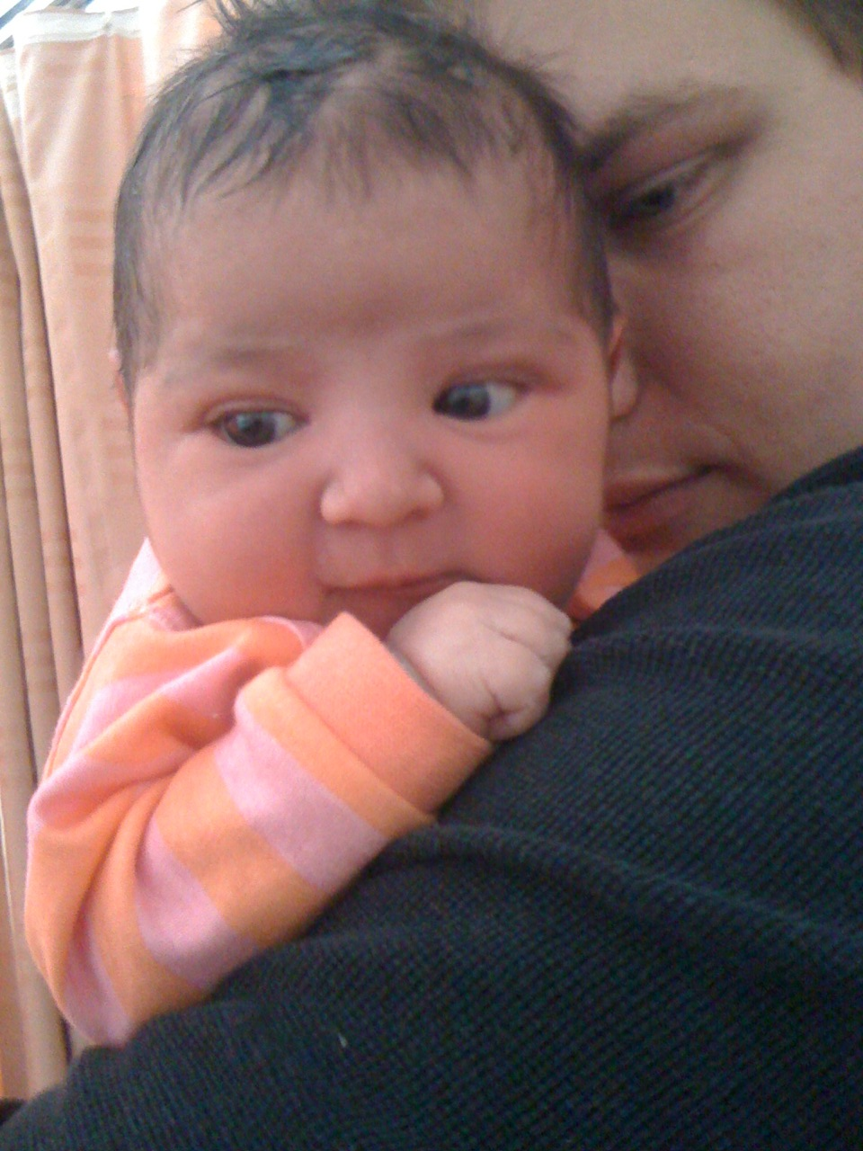
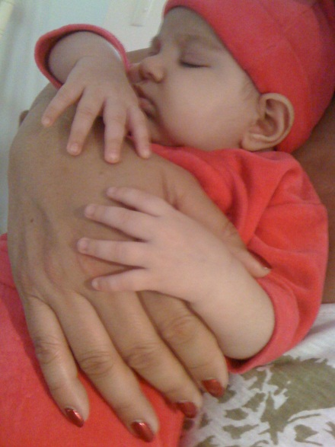
Manaaki

Slide 56
Manaaki - Support
Values
  Whole of Systems / Economic Leadership / Revenue Growth
  Incubation / Employment / Entrepreneurship / Enterprise
  Learning and Knowledge Culture
  Born Local – Grow Global
Cooperative Strategy / Organisation Support
  Incubate and grow entrepreneurs / Indigenous business
  Knowledge / Research, Design, Development
  Workforce development / Employment investment
Tactical Opportunities
  Tech. Innov. ICT. Academies and Hubs [school / marae / business]
  Products and Services [education / health / justice]
  Marketing and Sales Hubs / Indigenous Cloud / Broadcasting
Outcomes & Benefits
  Thriving Indigenous business – locally and internationally
  Thousands of Indigenous employed in the Sector
  Excellent R & D / Knowledge economy / Thousands of products / services
Notes:
MANAAKI

Slide 57
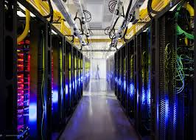
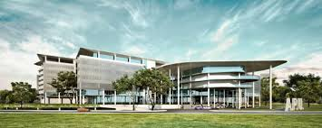
Rawa

Slide 58
Rawa - Achievement
Values
  From consumer to owner / Ethical production
  Solid asset foundation / Quality capital goods
  Future proofing / Sustain growth / Indigenous endowment anchor
Cooperative Strategy / Organisation Support
  Build assets portfolio / build infrastructure
  Tech Centres / Property / Broadband / Spectrum /Fibre
  Data Centres / Content delivery networks
Tactical Opportunities
  Create & consolidate Indigenous content
  Indigenous start-up / incubator / kick-starter
Outcomes & Benefits
  Solid and resilient assets foundation
  Certainty of business and employment growth
  Intergenerational benefits and succession
Notes:
RAWA

Slide 59
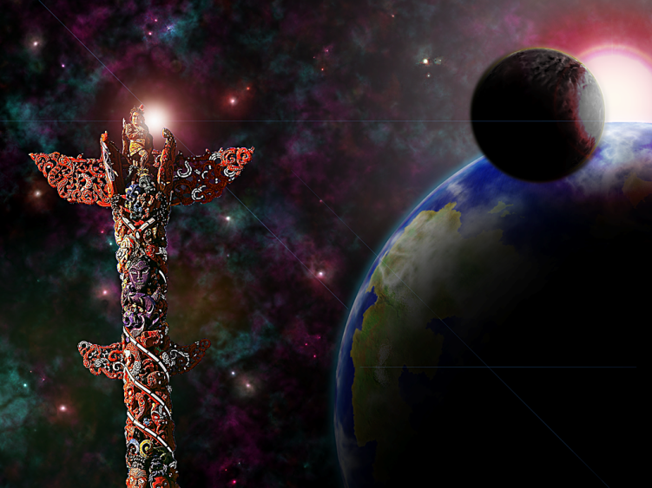
Rangatira Leadership

Slide 60
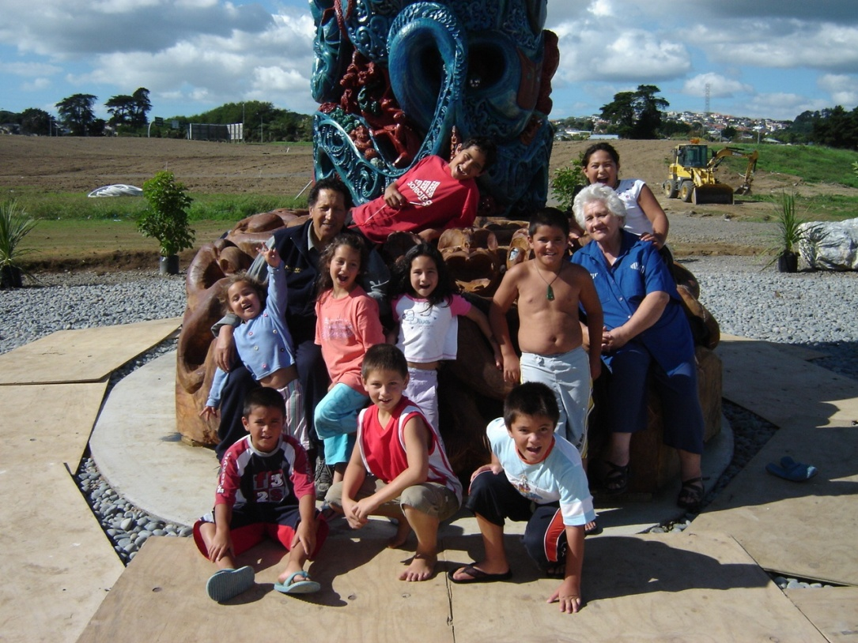
Rangatira - Leadership
Values
  Ethical Leadership / Locally Grounded Global Champions
  Integrated, Responsive Partnership
  Positive, Optimal, Equitable Outcomes for Indigenous
Cooperative Strategy / Organisation Support
  Achieve Global Brand / Local to Global reach
  Increase Indigenous economy / Economic wellbeing
  Build excellent systems to achieve community wealth and health
Tactical Opportunities
  Co-create Indigenous values-based evaluation systems
  Developing leadership opportunities for transformative learning
Outcomes & Benefits
  Recognition as Global Leaders
  Significant sustained economic growth of Sector / Organisation
  Improved economic wellbeing for Indigenous people
  Benefits for Indigenous economies and communities
Notes:
RANGATIRA

Slide 61
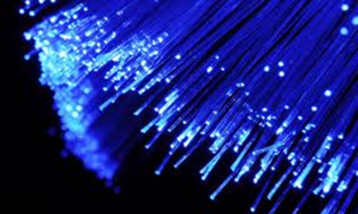
Opportunities for Collaboration
Infrastructure Development
Investment in Native STEM / Science Systems
R & D / Technology
Environmental Research
Engineering / Architecture / Design
Re-envisioning Education System
Industry – Recruitment / Retention
Technology / Data Centres/ Incubators
Workshops / Events / Knowledge Share
Cross-Sector (health / education / social)
Computer Science - 3D / AI / AR / VR

Slide 62
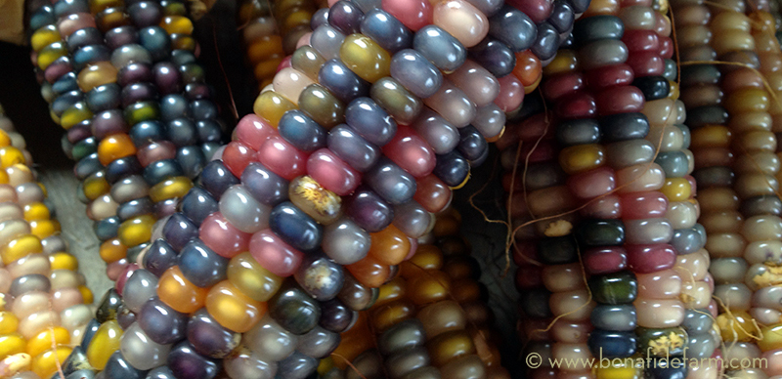
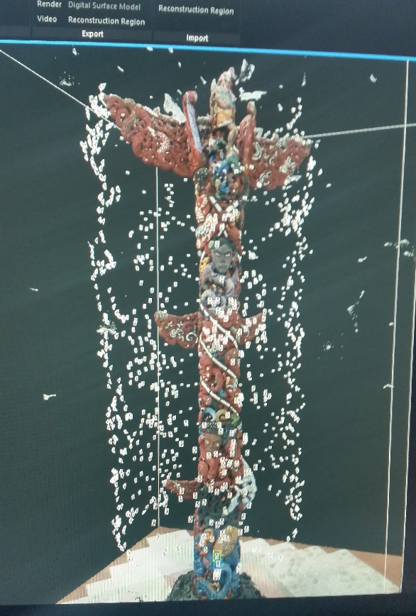
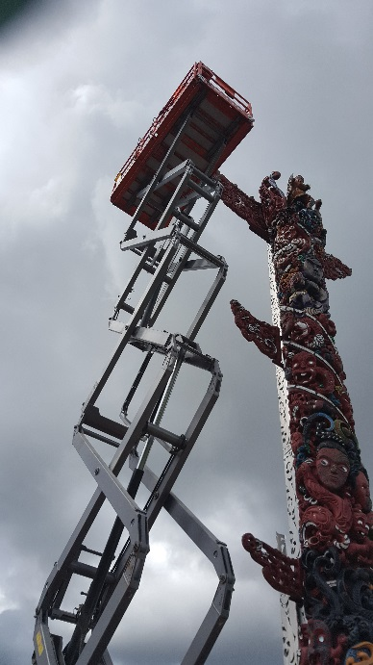


Sharing Pou Kapua in Virtual Reality …

Slide 63
Case Study 5
HAKAMANA
SmartPath Technology
Client-Centred Automated Technology

Slide 64
THE INTENTION
To work with a New Zealand team to create and utilise a tool which empowers health staff to communicate and collaborate across all levels of healthcare (secondary / primary / community)
THE Outcome
Smart Path Automated Healthcare - a cloud based tool which allows medical staff across the industry (local to global) to communicate, collaborate, and share data in real-time, revolutionising the way they can work – co-designed with IDESIGN MEDIA building on their Path technology

Slide 65
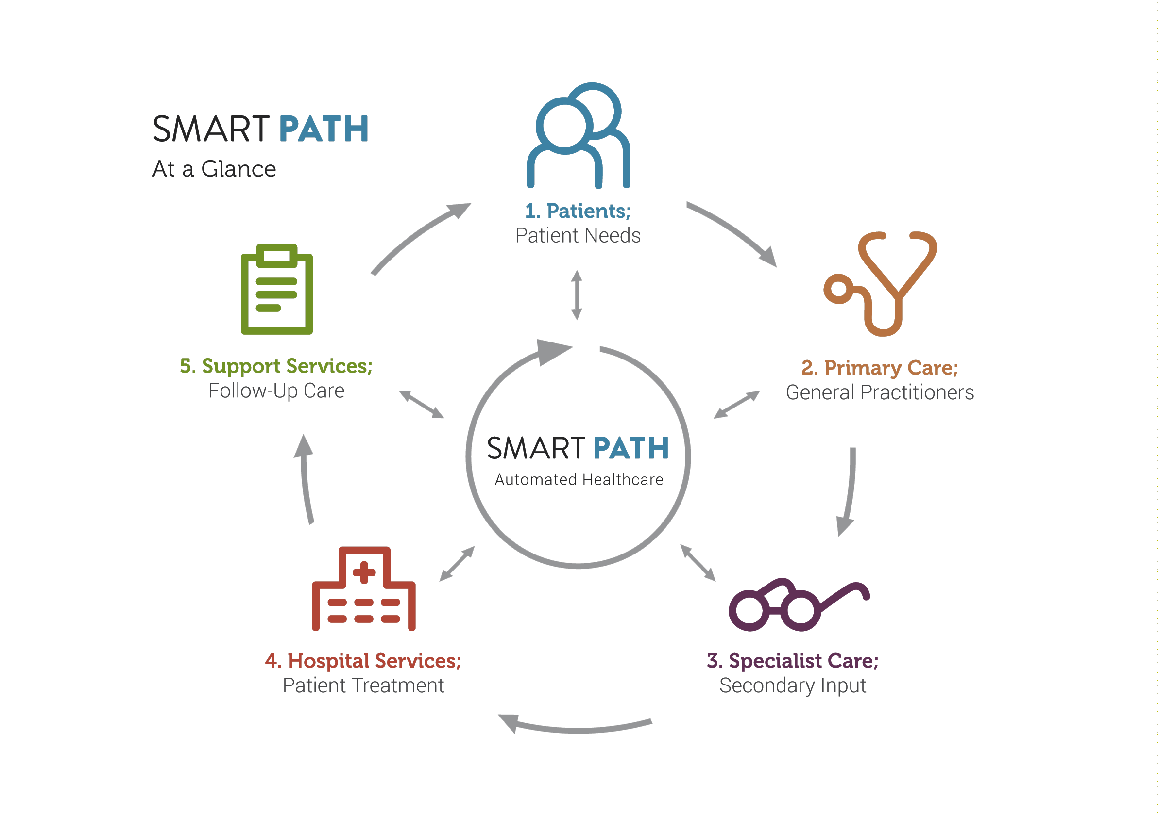
SmartPath Technologies
Automated Patient Pathways
Patient Care
Everyone…
All the Time…
Everywhere…

Slide 66
SmartPath – Patient-Centred Automated Healthcare
Features & Benefits
Smart Path enhances health care procedures with the following:
Input, access and share data within an intuitive, user-friendly interface
Use Patient Pathways to follow patients across various health care journeys in real-time
Facilitate relationships between primary and secondary care, specialists and support services
Use automated reminders and status features to manage any workload
Manage key information on the go with your smart phone, tablet, or laptop
Track changes made across the platform for system-wide transparency
Support various decision processes and workflows with comprehensive features
Whole of Systems approach across multiple sites, hospitals, and services

Slide 67
Opportunities for Collaboration
You can HAKAMANA
anything…anyone …anytime … anywhere
HAKAMANA
What is your vision …?
What do you want …?
What is your goal … ?

Slide 68

HAKAMANA … the kaupapa
Titiro
I
Vision
Kotahi
O
Relate
Rewa
E
Activate
Tupu
U
Sustain
Rawa
A
Achieve
Share
Lead
Co-Create Concepts
UI
IO
Realise
Benefit
Connect
Collaborate
AU
OE
EA
Question / Learn

Slide 69
Opportunities for Collaboration
HAKAMANA
If you would like to apply
the HAKAMANA System
to your situation,
contact Tania Wolfgramm
to discuss your needs
tania.wolfgramm@gmail.com

Slide 70
HAKAMANA – This document was prepared and presented by:
Tania Wolfgramm, HAKAMANA Systems
Wikuki Kingi, Tohunga, QSM
Pou Kapua - Creatrix
Aotearoa New Zealand
For further information about HAKAMANA
Contact Tania Wolfgramm
Tel: + 64 21 0876 1400
Email: tania.wolfgramm@gmail.com
The HAKAMANA System of Transformative Design, Development & Evaluation is Copyright © Tania Wolfgramm 2010.
LINKS www.hakamana.com www.poukapua.com www.smartpathhealthcare.com www.planetmaori.com
Photos are and images are courtesy Pou Kapua Creations; IDESIGN; Google Images

